Slide 1
ARPA Information
June 2022

Slide 2
What We’ll Cover:
Background
Vermont’s Share
Final Rule Basics
Spending
The “Standard Allowance”
Planning Framework
ARPA In Vermont
VLCT and RPCs

Slide 3
American Rescue Plan Act (ARPA) - $1.9 trillion stimulus package signed into law March 11, 2021
Coronavirus State and Local Fiscal Recovery Funds (“CSLFRF” or “ARPA”) - $350 billion for eligible state, local, territorial and Tribal governments
Purpose – To support governments in their response to and recovery from the COVID-19 public health emergency
U.S. Department of the Treasury (“Treasury”) will distribute the funding
Final Rule, issued by Treasury on January 6, 2022 (replaces the “interim final rule”) lays out the requirements of CSLFRF/ARPA funding
American Rescue Plan Act
Notes:
The American Rescue Plan Act was signed into law one year ago ​
​
Of many things, it created the State and Local Fiscal Recovery Fund – simply called ARPA ​
Its purpose is to help governments respond to and recover from the pandemic​
​
ARPA is implemented by the Final Rule which was just issued last month on January 6th and contains sweeping changes from the Interim Final Rule the Interim Final Rule which has been in effect since May 17, 2021.

Slide 4
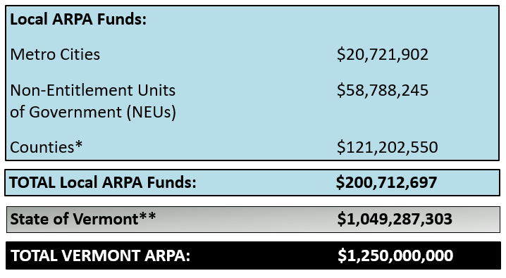
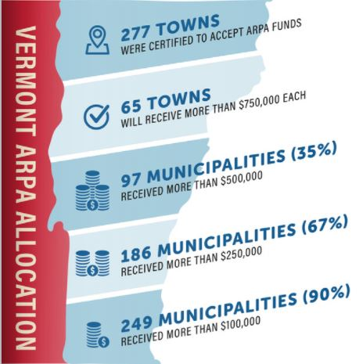
ARPA – Vermont’s Share
* County money has been reallocated to municipalities. Payments (local and county) can be found by clicking HERE.
** Only half the State money has been allocated. The remaining half will be allocated during the 2022
legislative session.
Notes:
VT will receive, $1.25 billion in ARPA money; a little over $200 million to cities, towns and villages and a little over $1 billion through the State of Vermont
​
Because VT does not have traditional county government, county ARPA funds were reallocated to municipalities making their awards much higher – about $300 per Vermonter.​
​
Of the $1 billion through the State of Vermont, much of this money will go out the door as grants – both direct assistance to households and businesses but also grants available to municipalities, for example to advance water and sewer projects​
​
Half of the State ARPA was allocated in the last legislative session. The remainder was allocated in the session that just ended.
​
As you can see in the image on the right, 90% of our towns received over $100,000 – for a town with under 1,000 people and only elected officials to administer the federal funding and all that goes along with it – it can be overwhelming​
​
The largest award – no surprise is Burlington – a little over $27 million and the smallest award is Victory at $18,957 (population 64)​

Slide 5
Issued January 6th, it took effect April 1, 2022, and replaces the Interim Final Rule, which has been in effect since May 17, 2021
The award period of performance ends December 31, 2026; all funds must be expended by this date
The Recipient is the ultimate arbiter of how funds will be spent; there is no higher authority or approval process
All municipalities will be required to report on their spending directly to Treasury using an online portal
All municipalities, excluding Burlington, have an annual reporting schedule, due by April 30th each year, 2022-2027
The
Final Rule
General Information
Notes:
​
The award relationship is directly between the municipality and Treasury – the State of Vermont has not oversight on local ARPA dollars​
​
All towns excluding Burlington have an annual reporting requirement – period closes March 31st, reporting due by April 30th​

Slide 6
What You CAN NOT Spend $ On
Changes Between the Interim Final Rule and the Final Rule
You still cannot “directly” fund:
“Extraordinary” deposits into pension funds
Contributions to rainy day funds, reserve funds, or satisfaction of a settlement or judgement
Outstanding Debt service
But now you can fund this:
Non-Federal Match is now allowed, explicitly for IIJA/BIL programs, but also generally as it is included under Section G., page 368 of the final rule, up to the amount of the recipient’s reduction in revenue; there is a new Expenditure Category for it – 6.2 Non-Federal Match for Other Federal Programs.
(Why do we this change? Because it allows towns to stretch their local ARPA awards!)
Notes:
The final rule is VERY clear about the types of things that ARPA funds cannot be spent on​
One of the items that moved from the DON’T to the DO list with the Final Rule was using your ARPA award to serve as non-federal match – this was not allowed under the interim final rule
​
This means towns, cities and villages are potentially sitting on tens or even hundreds of thousands of dollars of potential required grant match for forthcoming additional federal funds, like infrastructure money, as well as existing grant programs
If your town ever struggled to come up with 10%, 20%, or even 50% required match for a grant program, your ARPA funds can now help you cross this hurdle
​

Slide 7
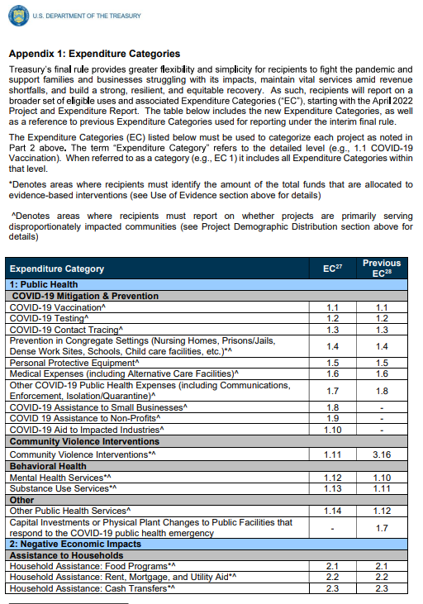
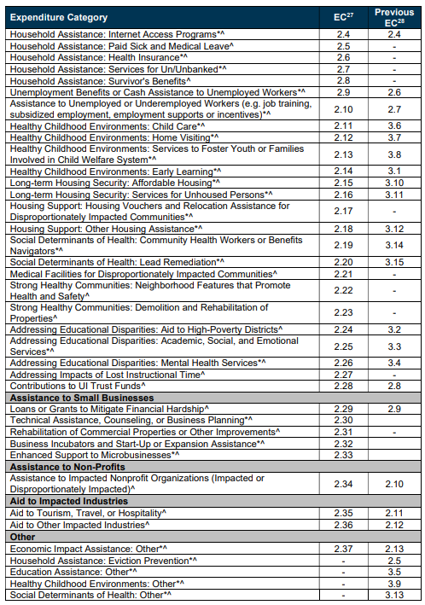
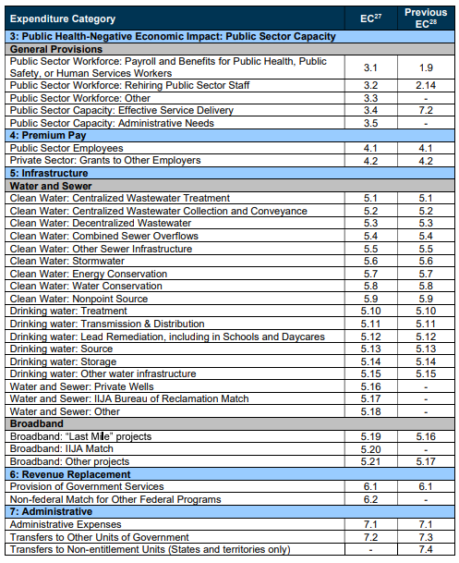
What You CAN Spend $ On
For most Vermont towns, all spending
will fall under this Expenditure Category…….
Notes:
So, what can towns spend their ARPA money on?​
Well, basically all the same general categories as you could with the Interim Final Rule but now they are broken out into 83 Expenditure Categories – up from the 66
​
For small, rural communities, like we have here in Vermont, most of the categories are either not applicable or just too restrictive and don’t allow the funding to be spent to meet each community’s unique and actual needs​
​
However, there is one Category - #6 Revenue Replacement - which gives towns broad latitude in how they can spend their funds​ up to the amount of their revenue loss​

Slide 8
Recipients made “a one-time, irrevocable election to utilize either the revenue loss formula or the standard allowance” during the April 30, 2022, reporting period
For NEUs, the entire amount of your municipality’s ARPA award may be taken as “lost revenue”
Treasury “presumes” this amount is revenue loss – there is no need to calculate, demonstrate or document it
EC 6.1 Government services generally include any service traditionally provided by a government
All spending of ARPA funds up to the amount of revenue loss, regardless of purpose, will be reported under EC 6.1 Government Services.
Expenditure Category 6
Revenue Replacement
Notes:
So what does this actually mean? ​
​
Municipalities may now spend their ARPA awards on the provision of “government services”​
​
Any service typically provided by “A” government​ - even if your town has not provided the service before, that is ok
​
This can range from bolstering town operations like IT upgrades, cybersecurity, digitizing land records to improving community gathering spaces, to supporting local non-profits, to buying equipment for firefighters, highway crews, roads and bridges, etc. ​
VLCT has three basic rules to guide your ARPA decision:
If it is illegal to spend your taxpayers'’ money on it, don’t spend your ARPA award on it
If it presents a conflict of interest or even the appearance of a conflict, don’t spend your ARPA award on it
If it isn’t something you would ask your taxpayers to consider funding, don’t spend your ARPA award on it

Slide 9
Your ARPA Award
Your decisions should prepare your community for the next disaster, position future generations for success, and, whenever possible, help grow your Grand List.
As you make plans to spend your ARPA award, think of these as your guide:
Use existing tools.
Don’t reinvent the wheel.
Stretch your ARPA dollars.

Slide 10
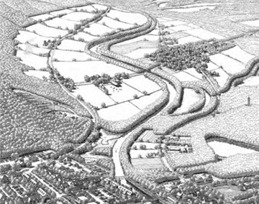
Use Existing Tools.
With so much flexibility in spending ARPA funds now, how do you prioritize?
Here are some ideas to help establish selection criteria. Does/Is the use:
Follow the intent of CSLFRF/ARPA?
Fight the pandemic and support families and businesses struggling with its public health and economic impacts
Maintain vital public services, even amid declines in revenue resulting from the crisis
Build a strong, resilient, and equitable recovery by making investments that support long-term growth and opportunity
Comply with the Town Plan?
Included in a Master Plan or any other plans, studies or reports?
Included in a Capital Improvement Plan, if one exists?
Set a precedent that will be difficult for the Town to fulfill for others in the future?
Create an ongoing unfunded expense, after ARPA is exhausted?
Have broad community benefit, or does it benefit just a few?
Bring long-term value to the community for generations to come?
Leverage other grant funds?
Duplicate benefit - already funded through an existing program (State or other)?

Slide 11
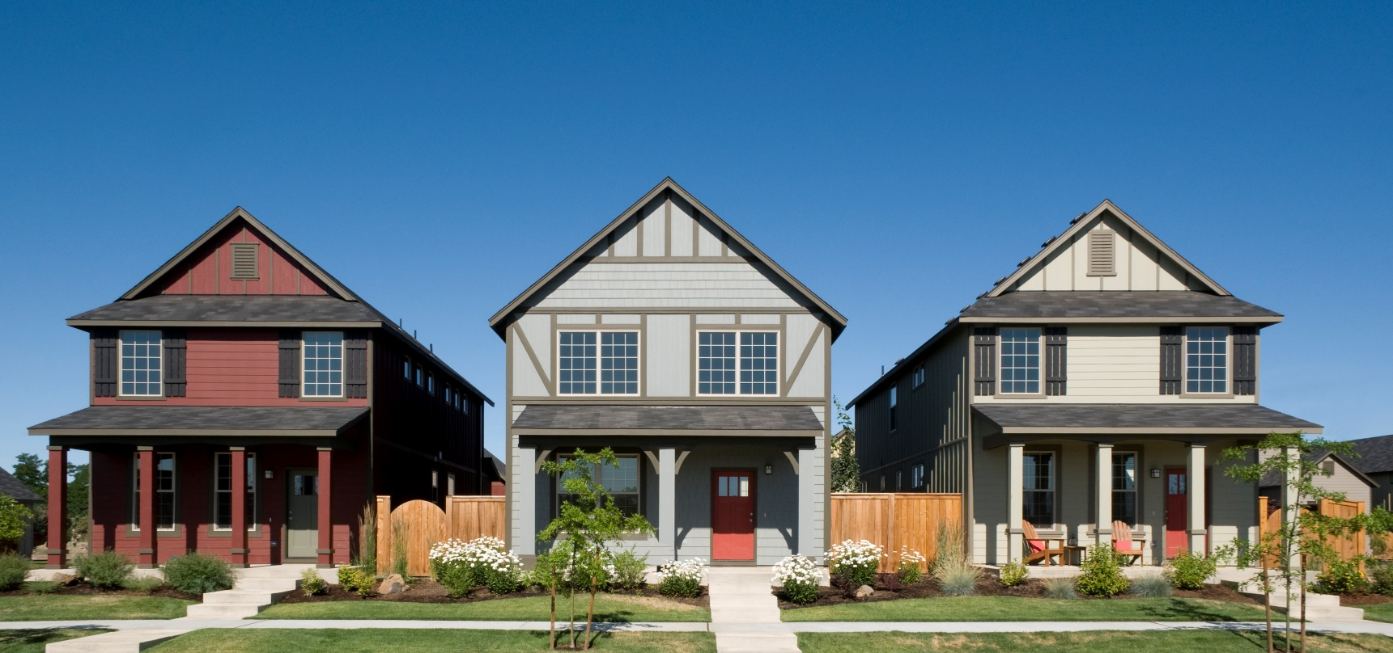
Don’t Reinvent the Wheel.
Assistance to Individuals and Households:
Vermont Emergency Rental Assistance Program (VERAP) - $110 million in Coronavirus Relief Funds - Assistance to renters for rent and utilities.
Vermont Homeowner Assistance Program (VT HAP) – $50 million State ARPA - Assistance with overdue mortgage payments, homeowners’ association fees, property taxes, and/or utilities.
Affordable Connectivity Program (ACP) – $14 billion, federally - Assistance for internet service.
Assistance to Businesses:
VT Agency of Commerce and Community Development (ACCD) - There have been numerous COVID-19 economic relief & recovery programs for business as well as existing programs.
Regional Development Corporations (RDCs) – There are twelve RDCs throughout VT. They serve as “satellites” of the VT Dept. of Economic Development and provide local knowledge and facilitate assistance to support businesses in their communities.
More resources can be found here:
Housing Resources for Vermonters in Need
ACCD Grant Opportunities Inventory Dec 2021

Slide 12
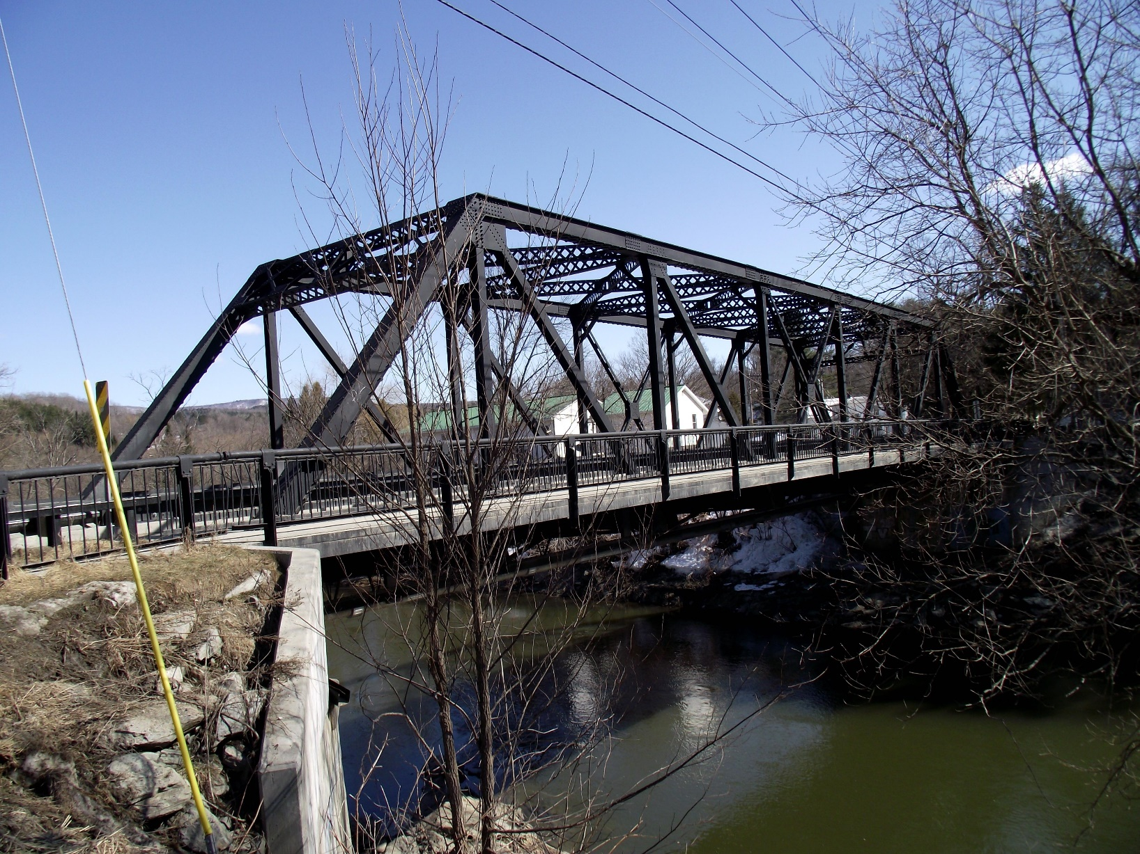
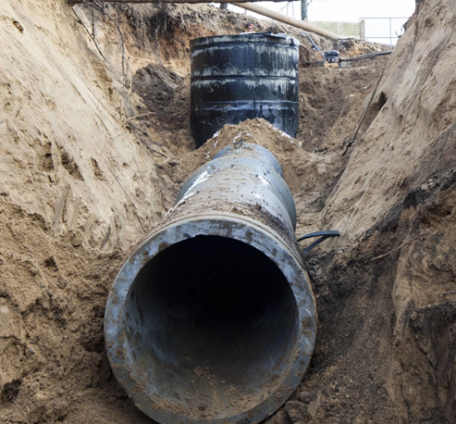
Stretch Your ARPA Dollars.
There are billions of federal dollars pouring into Vermont – more than we will ever see again in our lifetimes. Use your ARPA dollars as grant match to leverage other programs for:
Water and sewer
Broadband
Repair/rebuild roads and bridges
Safe Streets
EV Charging Stations
Improvements to municipal buildings

Slide 13
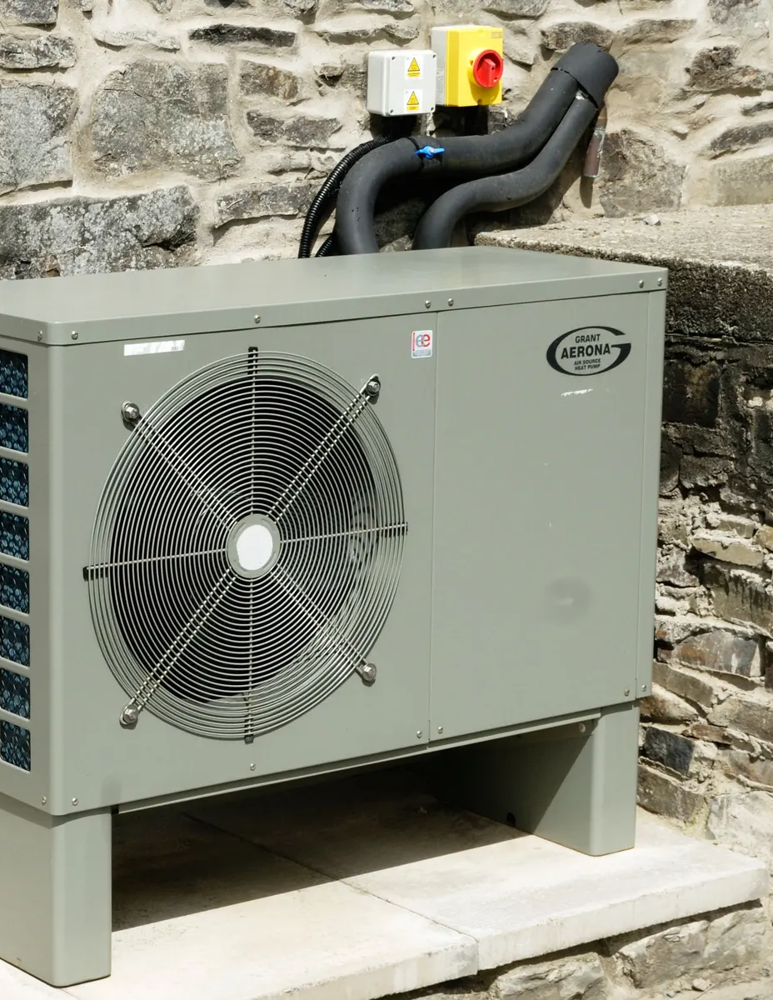
ARPA – Vermont
Based on the hundreds of municipal inquiries VLCT has received to date regarding local ARPA funding, here is a non-exhaustive list of items that many communities throughout Vermont are considering in their spending plans…
Investments to improve municipal business operations:
Cybersecurity, IT Upgrades, town websites
Hybrid meeting equipment
Connect public buildings to broadband
Digitize land records
Capital improvements to municipal buildings:
Ventilation and energy
ADA accessibility, fire protection, general code upgrades
Create a formal Capital Plan
Seeding positions to help advance local priorities and projects
Improvements in communication with the public and delivery of services:
Hybrid meeting equipment
Website improvements
Digitizing land records
IT upgrades; cybersecurity
Connection to broadband
Capital improvements to municipal buildings:
Ventilation and energy
ADA accessibility, general code improvements
Creating formal capital plans

Slide 14
ARPA - Vermont (continued)
Investments that revitalize a community, making it a better and safer place to live for existing residents and to help in attracting new ones:
Outdoor recreation (trails, parks, green spaces, recreational facilities, etc.)
Diversity, equity, inclusion (DEI)
High-quality affordable childcare
Measures to support housing development
Bike and pedestrian safety
Community gathering spaces
Broadband
Support for local non-profits

Slide 15
Guidance and project eligibility analysis
Webinars, targeted trainings, technical assistance, best practices
In-person and virtual meetings with local officials and staff
Answer questions (arpa@vlct.org)
Guidance with compliance, reporting, and transparency
Collaboration/partnerships with RPCs, SOV, RDCs, statewide non-profits, private consultants, etc. to ensure needs of municipalities are met related to project ideation, implementation and management
www.vlct.org/arpa
ARPA Assistance and Coordination Program

Slide 16
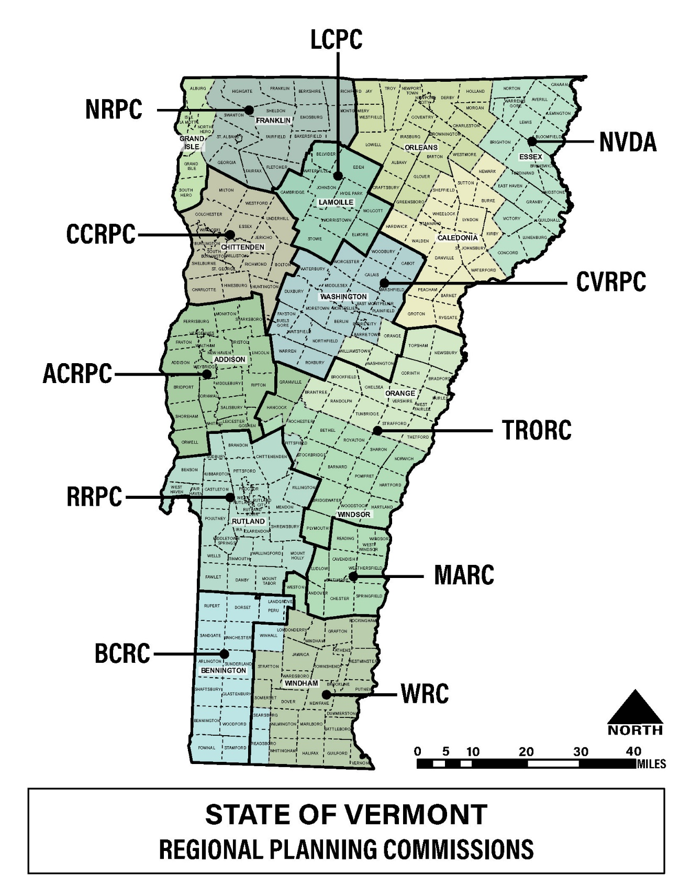
Regional Planning Commission Assistance
Identify needs and top priorities for designing and building projects that are consistent with existing State, regional and local plans.
Respond to inquiries on eligibility to facilitate local discussions among stakeholders on specific projects.
Provide other assistance as needed from local communities in coordination with VLCT.
Work with VLCT, regional development corporations, and private consultants working with municipalities to ensure needs of local communities are met, especially related to project development and management.
For more information on the State of Vermont’s 11 Regional Planning Commissions visit: www.vapda.org

